Slide 1


Slide 2

Def.: ?????
2 typy: ?????

Slide 3

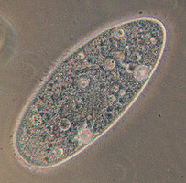
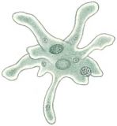

Slide 4



Slide 5



Slide 6

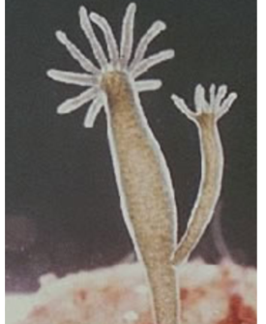

Slide 7


Slide 8


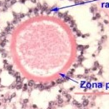

Slide 9


